Slide 1
Applied Data Science 2
Dr Ashley SpindLer
Semester A, 2022

Slide 2
Lecture 4 - Outcomes
Learn about the core concepts behind the Keras Machine Learning API
Understand the principles of computer vision
Examine how convolutional layers function to process image data

Slide 3

Keras – A Deep Learning API
Simple -- but not simplistic. Keras reduces developer cognitive load to free you to focus on the parts of the problem that really matter.
Flexible -- Keras adopts the principle of progressive disclosure of complexity: simple workflows should be quick and easy, while arbitrarily advanced workflows should be possible via a clear path that builds upon what you've already learned.
Powerful -- Keras provides industry-strength performance and scalability: it is used by organizations and companies including NASA, YouTube, or Waymo.
https://keras.io/about/

Slide 4
Keras – Layers and Models

Slide 5
Keras – Layers and Models
Layers are the basic building blocks of Keras Models:
Layers operate on a Tensor-in, Tensor-out computation function
A Layer is a Class, not a Function, and stores it’s current state as tf.Variables
The Layers state is usually the weights and biases of the neurons in the layer

Slide 6
Keras – Layers and Models
Layers are the basic building blocks of Keras Models:
Layers operate on a Tensor-in, Tensor-out computation function
A Layer is a Class, not a Function, and stores it’s current state as tf.Variables
The Layers state is usually the weights and biases of the neurons in the layer
Keras Models come in two forms: Sequential and Functional Models

Slide 7
Keras – Layers and Models
Layers are the basic building blocks of Keras Models:
Layers operate on a Tensor-in, Tensor-out computation function
A Layer is a Class, not a Function, and stores it’s current state as tf.Variables
The Layers state is usually the weights and biases of the neurons in the layer
Keras Models come in two forms: Sequential and Functional Models
Sequential Models are a linear stack of layers that takes in some input and calculates some output.

Slide 8
Keras – Layers and Models
Layers are the basic building blocks of Keras Models:
Layers operate on a Tensor-in, Tensor-out computation function
A Layer is a Class, not a Function, and stores it’s current state as tf.Variables
The Layers state is usually the weights and biases of the neurons in the layer
Keras Models come in two forms: Sequential and Functional Models
Sequential Models are a linear stack of layers that takes in some input and calculates some output.
Functional Models are more complex, and allow for customisation of how the tensors are passed through the model

Slide 9
Computer Vision

Slide 10
Computer Vision
A field of study that is concerned with how computers see images and video, and building models to complete tasks based on that sight.

Slide 11

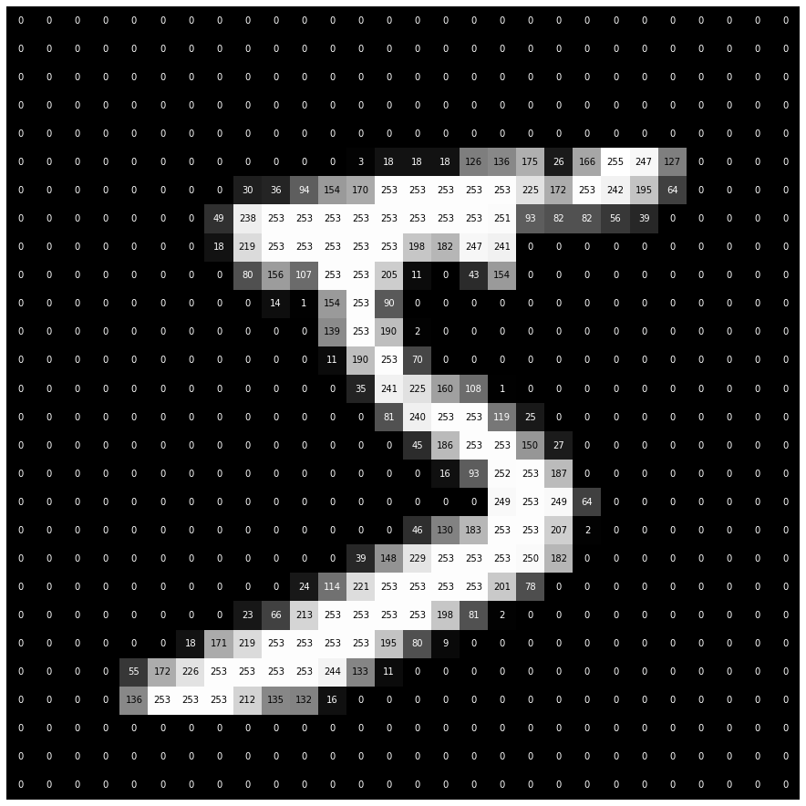
What do computers see?

Slide 12

What do computers see?

Slide 13

Image Classification
One of the most common forms of supervised learning is identifying the contents of an image
This is a task that humans are VERY good at—in most cases—but is harder than it looks for a computer
Predictions of labels are often expressed as probabilities—95% chance the image is a cat
Cat? Or Dog?

Slide 14
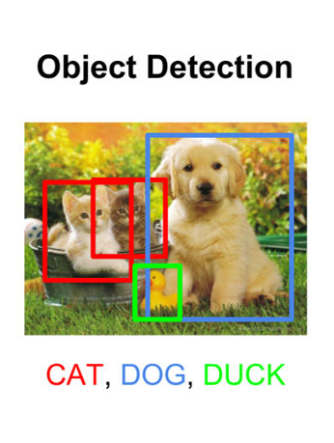
Object Detection
Like image classification, object detection attempts to predict the contents of an image, but now with multiple objects, not just a single one
The models are trained to predict the “Bounding Boxes” of objects in the image, and apply labels for the contents of each box

Slide 15

Image Generation
Increasingly popular in the last few years, training models to create images, either from scratch or with a prompt, has many applications.
Rise of Stable Diffusion has lead to an explosion of “AI Art”, but other models include VAEs and Generalised Adversarial Nets (GANs)
Can be used for image restoration and scene reconstruction.

Slide 16
Summary: Computer Vision
Computer vision covers a wide range of tasks and fields of research.
At the core is understanding what computers “see”—matrices of numbers.
But how do we go from these matrices to models?

Slide 17
Convolutional Neural Networks
CNNs are a kind of neural network that are specifically tailored for classifying images.
Inspired by biological visual fields, they leverage the spatial information of the pixels in an image.
They build on the information from single pixels into simple geometric forms, and then into more complex objects, such as faces or animals.

Slide 18
Deep CNNs
DCNNs are made of many layers. Typically these are convolutional and pooling layers.
A convolution takes a sub-region of an image as input into a single neuron, and strides this subregion across the whole image.
Pooling layers reduce the size of an image, but taking, for example, the maximum value in a subregion.

Slide 20
Convolutional Layers
Input Shape
8x8
Kernel
3x3
Padding = ‘valid’

Slide 21
Convolutional Layers
Input Shape
8x8
Local Receptive Field
Kernel
3x3
Padding = ‘valid’

Slide 22
Convolutional Layers
Input Shape
8x8
Local Receptive Field
The local receptive field refers to the subregion of pixels that the kernel acts upon. The output of the layer, the feature maps, have one pixel (i.e. one neuron) for each local receptive field.
Kernel
3x3
Padding = ‘valid’

Slide 23
Convolutional Layers
Stride
2x2
Input Shape
8x8
The kernel is strided along the image, each stride feeds into another output neuron. Importantly, the neurons all share the same weights for the kernel. This allows the kernel to learn the same feature, regardless of it’s local position in the image.
Kernel
3x3
Padding = ‘valid’

Slide 24
Convolutional Layers
Stride
2x2
Input Shape
8x8
1 | 1 | 1 | 0 | 0
0 | 1 | 1 | 1 | 0
0 | 0 | 1 | 1 | 1
1 | 0 | -1
1 | 0 | -1
1 | 0 | -1
Kernel
3x3
Padding = ‘valid’

Slide 25
Convolutional Layers
Stride
2x2
Input Shape
8x8
1 | 1 | 1 | 0 | 0
0 | 1 | 1 | 1 | 0
0 | 0 | 1 | 1 | 1
Output Shape
3 x 3
1 | 0 | -1
1 | 0 | -1
1 | 0 | -1
-2 | 2
Kernel
3x3
Feature Map
Padding = ‘valid’

Slide 26
Convolutional Layers
Stride
2x2
Input Shape
8x8
…
64 Kernels
…
Padding = ‘valid’

Slide 27
Convolutional Layers
Stride
2x2
Input Shape
8x8
Output Shape
64 x 3 x 3
…
…
64 Kernels
…
…
Padding = ‘valid’

Slide 28
Convolutional Layers
Stride
2x2
Input Shape
8x8
 |  |  |  |  |  |  |  | 0
 |  |  |  |  |  |  |  | 0
 |  |  |  |  |  |  |  | 0
 |  |  |  |  |  |  |  | 0
 |  |  |  |  |  |  |  | 0
 |  |  |  |  |  |  |  | 0
 |  |  |  |  |  |  |  | 0
 |  |  |  |  |  |  |  | 0
0 | 0 | 0 | 0 | 0 | 0 | 0 | 0 | 0
Output Shape
64 x 4 x 4
…
…
64 Kernels
…
…
Padding = ‘same’

Slide 29
Convolutional Layers
Stride
1x1
Input Shape
8x8
 |  |  |  |  |  |  |  | 0
 |  |  |  |  |  |  |  | 0
 |  |  |  |  |  |  |  | 0
 |  |  |  |  |  |  |  | 0
 |  |  |  |  |  |  |  | 0
 |  |  |  |  |  |  |  | 0
 |  |  |  |  |  |  |  | 0
 |  |  |  |  |  |  |  | 0
0 | 0 | 0 | 0 | 0 | 0 | 0 | 0 | 0
Output Shape
? x ?
Kernel
3x3
Padding = ‘same’
Filters = 64

Slide 30
Convolutional Layers
Stride
1x1
Output Shape
8 x 8
Input Shape
8x8
Filters = 64
 |  |  |  |  |  |  |  | 0
 |  |  |  |  |  |  |  | 0
 |  |  |  |  |  |  |  | 0
 |  |  |  |  |  |  |  | 0
 |  |  |  |  |  |  |  | 0
 |  |  |  |  |  |  |  | 0
 |  |  |  |  |  |  |  | 0
 |  |  |  |  |  |  |  | 0
0 | 0 | 0 | 0 | 0 | 0 | 0 | 0 | 0
…
Kernel
3x3
Padding = ‘same’
…

Slide 31
Basic Layers – Conv2D
The core layer in image recognition networks is the 2-D spatial convolution.
The network stores a number of Filters which Stride across the input image to produce an output of Activation Maps. Each Filter is made up of a Kernel with a given size, containing weights and biases.
Input images may be Padded before computation.

Slide 32
Basic Layers – Conv2D
The core layer in image recognition networks is the 2-D spatial convolution.
The network stores a number of Filters which Stride across the input image to produce an output of Activation Maps. Each Filter is made up of a Kernel with a given size, containing weights and biases.
Input images may be Padded before computation.
from tensorflow.keras.layers import Conv2D
conv = Conv2D(filters = 64,
kernel_size = (3, 3),
strides = (1, 1),
padding = ‘valid’,
activation='relu’)

Slide 33
Pooling Layers
The other important aspect of DCNN is the pooling layers.
Pooling allows us to summarise the information in a feature map, by utilising the spatial information in the data.
For a subregion of the feature map, we can produce a single value that synthetically describes the “meaning” of that region.

Slide 34
Pooling Layers
The other important aspect of DCNN is the pooling layers.
Pooling allows us to summarise the information in a feature map, by utilising the spatial information in the data.
For a subregion of the feature map, we can produce a single value that synthetically describes the “meaning” of that region.
Max Pooling
1 | 0 | 3 | 6
2 | 4 | 5 | 2
2 | 6 | 2 | 0
3 | 4 | 1 | 7
4 | 6
6 | 7

Slide 35
Pooling Layers
The other important aspect of DCNN is the pooling layers.
Pooling allows us to summarise the information in a feature map, by utilising the spatial information in the data.
For a subregion of the feature map, we can produce a single value that synthetically describes the “meaning” of that region.
from tensorflow.keras.layers import MaxPool2D
pool = MaxPool2D(
pool_size = (2, 2),
strides = (2, 2),
padding = ‘valid’,)

Slide 36
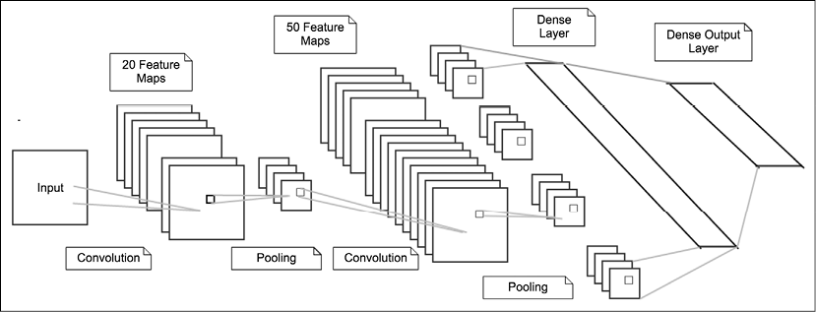
Example: LeNet (LeCun 1995)
Deep Learning with TensorFlow2 and Keras – Second Edition, Chapter 4, Figure 5

Slide 37
Review
Keras is built on two core concepts – Layers and Models
Layers contain the operations that transform tensors from an input into an output, they include fully-connected (dense) layers, and convolutional layers
Models can be created using the Sequential API—where the model is a linear stack of layers—or with the more customisable Functional API

Slide 38
Questions???

